Slide 1


Slide 2
Instructions
This social story includes information and images about a location, specific teachers and specific coding applications. Please modify to suit your needs.
Text in RED indicates information that needs to be added.
Grey image placeholders indicate images that would be beneficial to have included. Placeholders can be deleted after images are inserted.
This is a sample and can be edited or replicated.

Slide 3
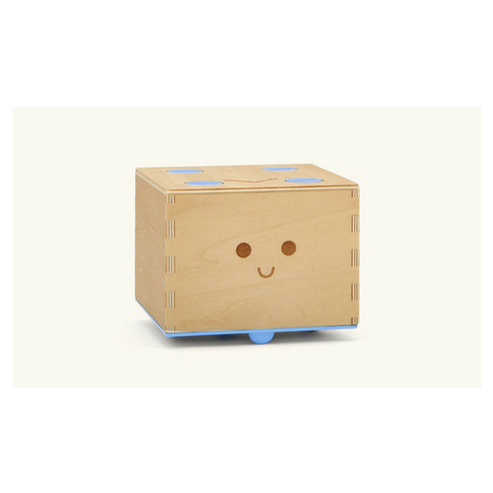
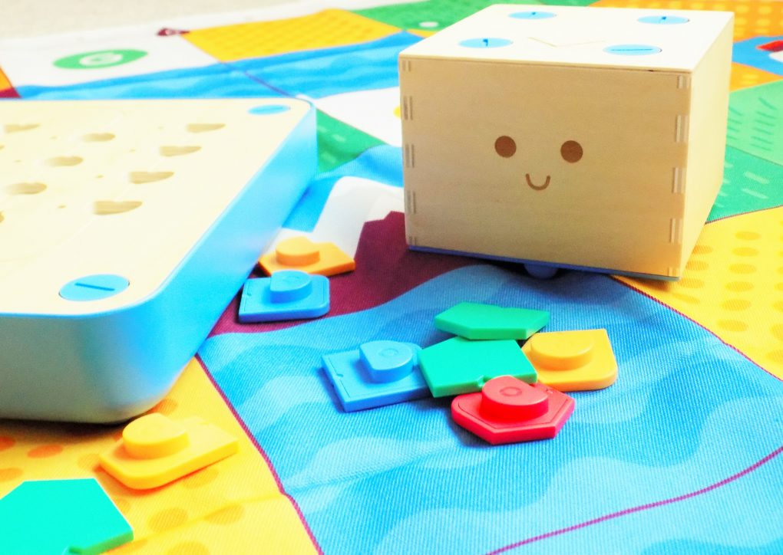
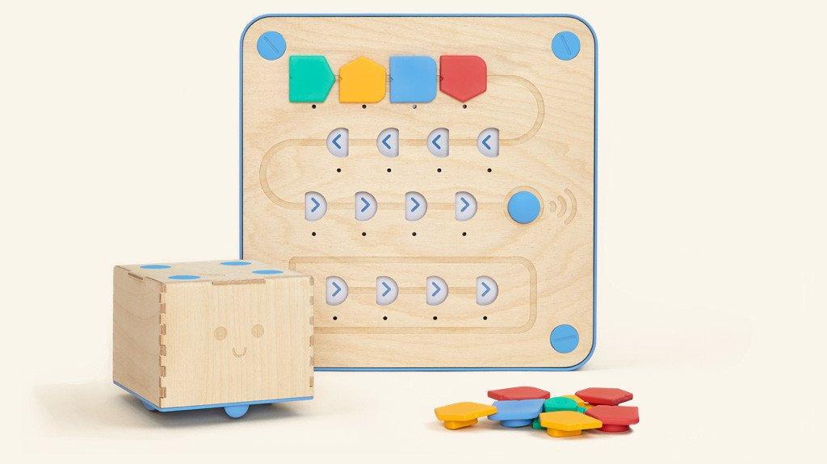
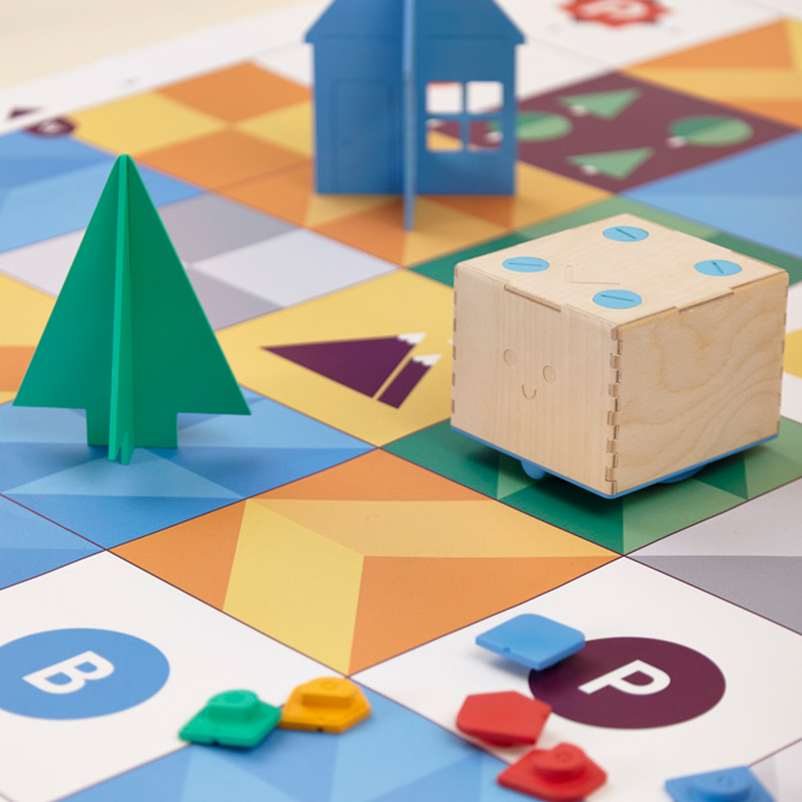
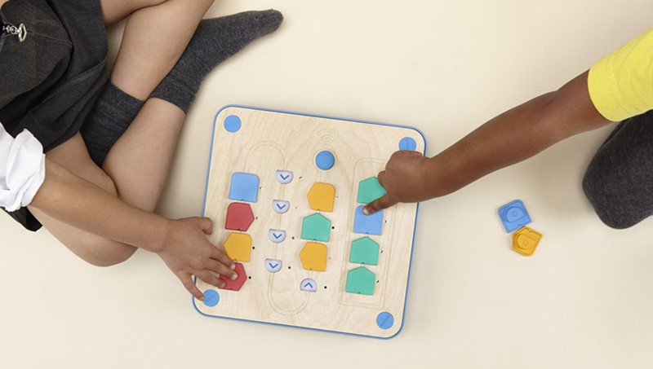

Learning about Cubetto

Slide 4
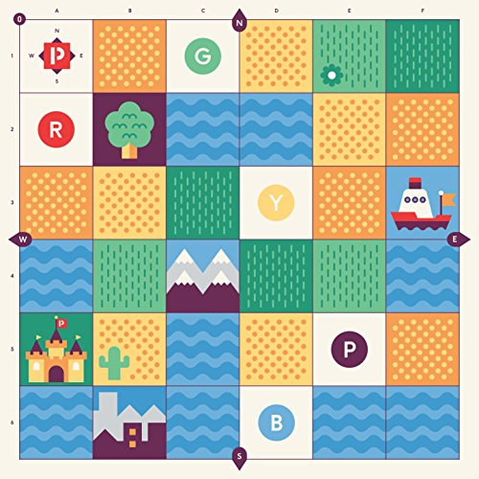
<Name of location> I will be learning about robots. The robot I will learn about is called Cubetto.
map
control panel
Cubetto
command blocks

Slide 5
<name of person(s)> will be teaching me about Cubetto.
Place image of instructor here
Place image of instructor here
name
name

Slide 6

I will not be able to play with the other toys I normally play with.
Place image(s) of room locations/materials that will be off limits behind the “do not” symbol

Slide 7
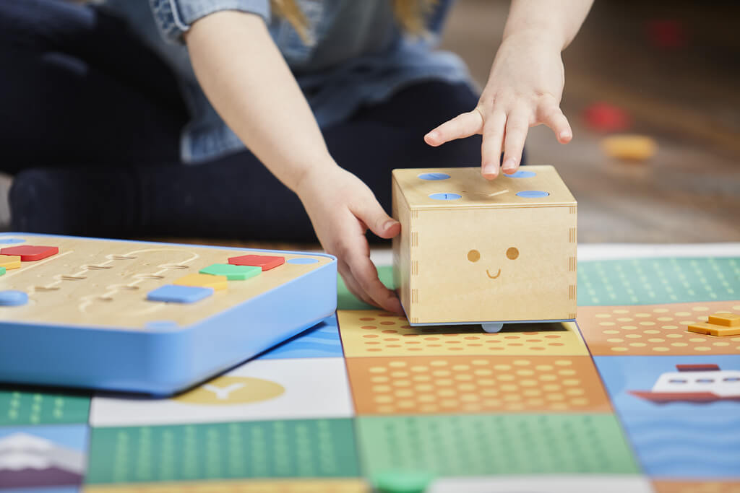
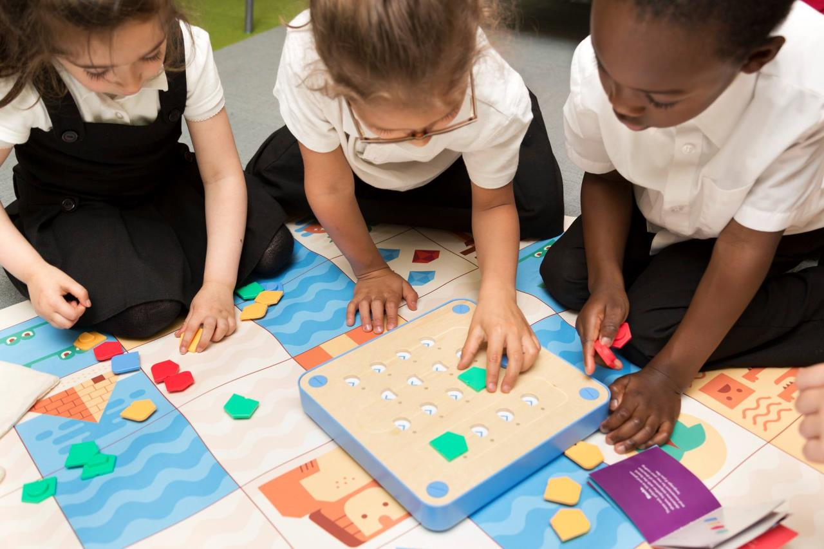
I will get to use Cubetto, but I will have to be careful with him. I will not be able to play with Cubetto like a toy.

Slide 8

<name of person(s)> will explain how to use Cubetto properly.
Place image of instructor here
Place image of instructor here
name
name

Slide 9
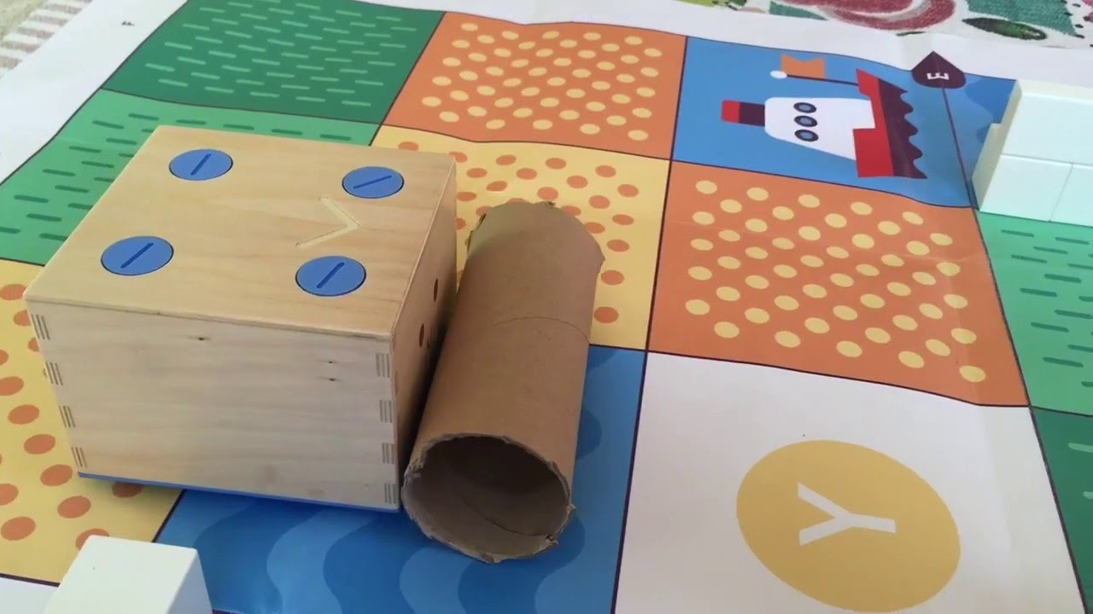
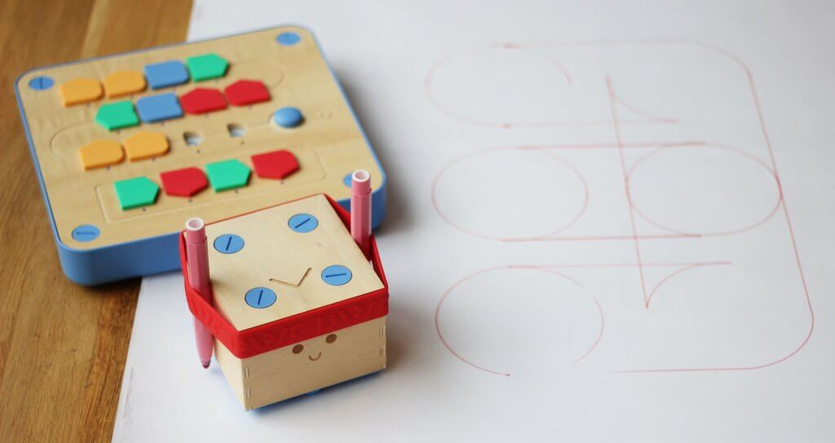
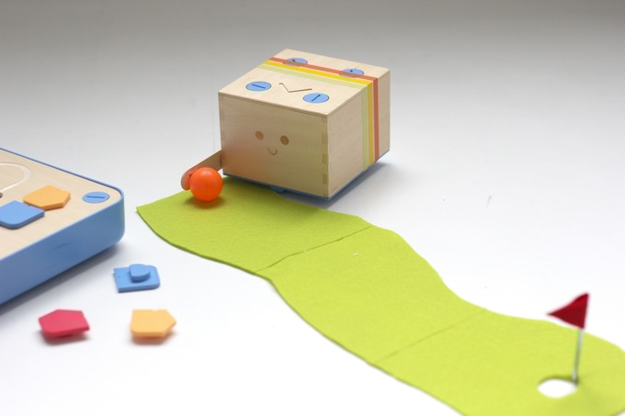
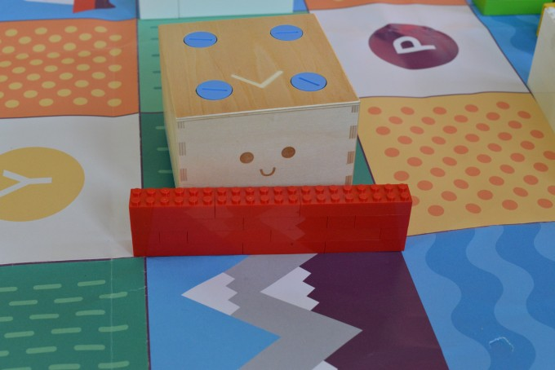
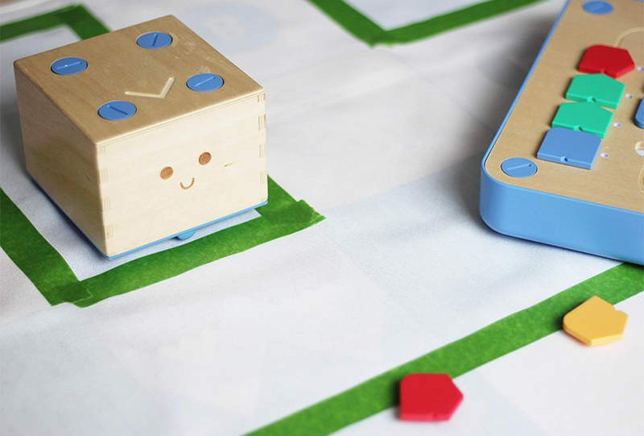
I will learn how to make Cubetto do some fun and silly things.

Slide 10
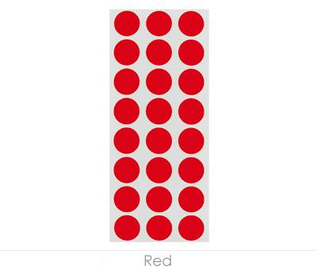
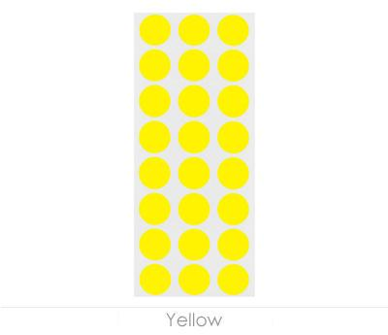
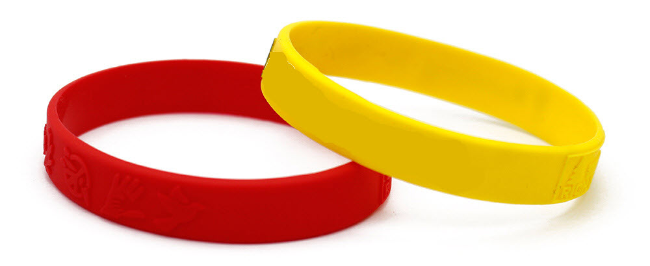
Some of the things I will learn about might be tricky to understand. <name of person(s)> will try to make it easy for me by having me wear wristbands or stickers on my hands.

Slide 11
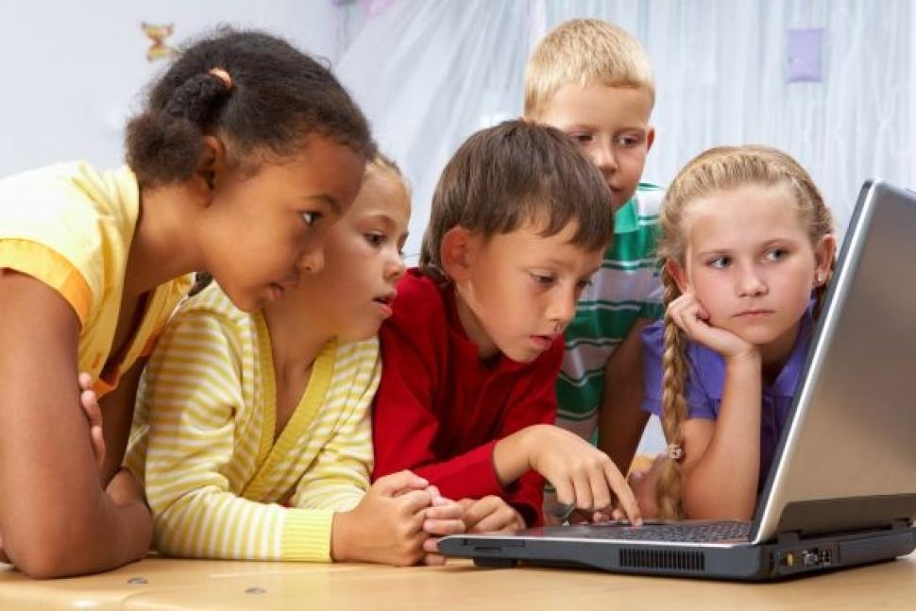
There will be other students at <name of place> learning about Cubetto too.

Slide 12
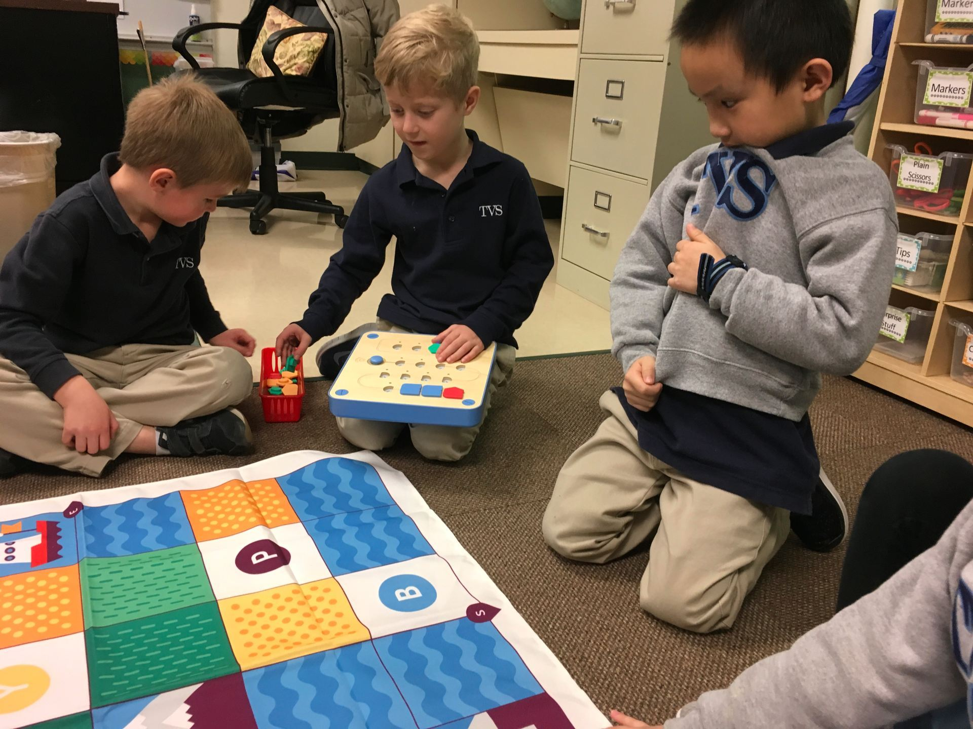
Sometimes, I might have to wait my turn to use Cubetto.
<name of person(s)> will always make sure I get a turn.

Slide 13

Together we will all have fun learning about Cubetto!

Slide 14
Image Credits:
Title page
Cubetto:
https://www.jrtoycanada.ca/primo-toys-cubetto-playset-coding-toy.html
Children playing with Cubetto:
https://interestingengineering.com/cubetto-programmable-wooden-robot-teaches-kids-code
Cubetto on map with command pieces:
https://newyoungmum.com/cubetto-the-little-robot-perfect-for-children/
Page 6
Image on right:
http://santaclaraca.gov/Home/Components/Calendar/Event/53115/1276
Page 8
Cubetto with paper roll:
https://www.youtube.com/watch?v=2avlslrP_C4
Cubetto with Lego Block:
https://www.pinterest.ca/pin/202662051960493132/?lp=true
Cubetto in Tape Maze:
https://www.generationrobots.com/en/402714-cubetto.html
Page 11
http://tvstechtips.edublogs.org/2018/02/25/cubetto-the-perfect-robot-for-young-learners/

